Slide 1
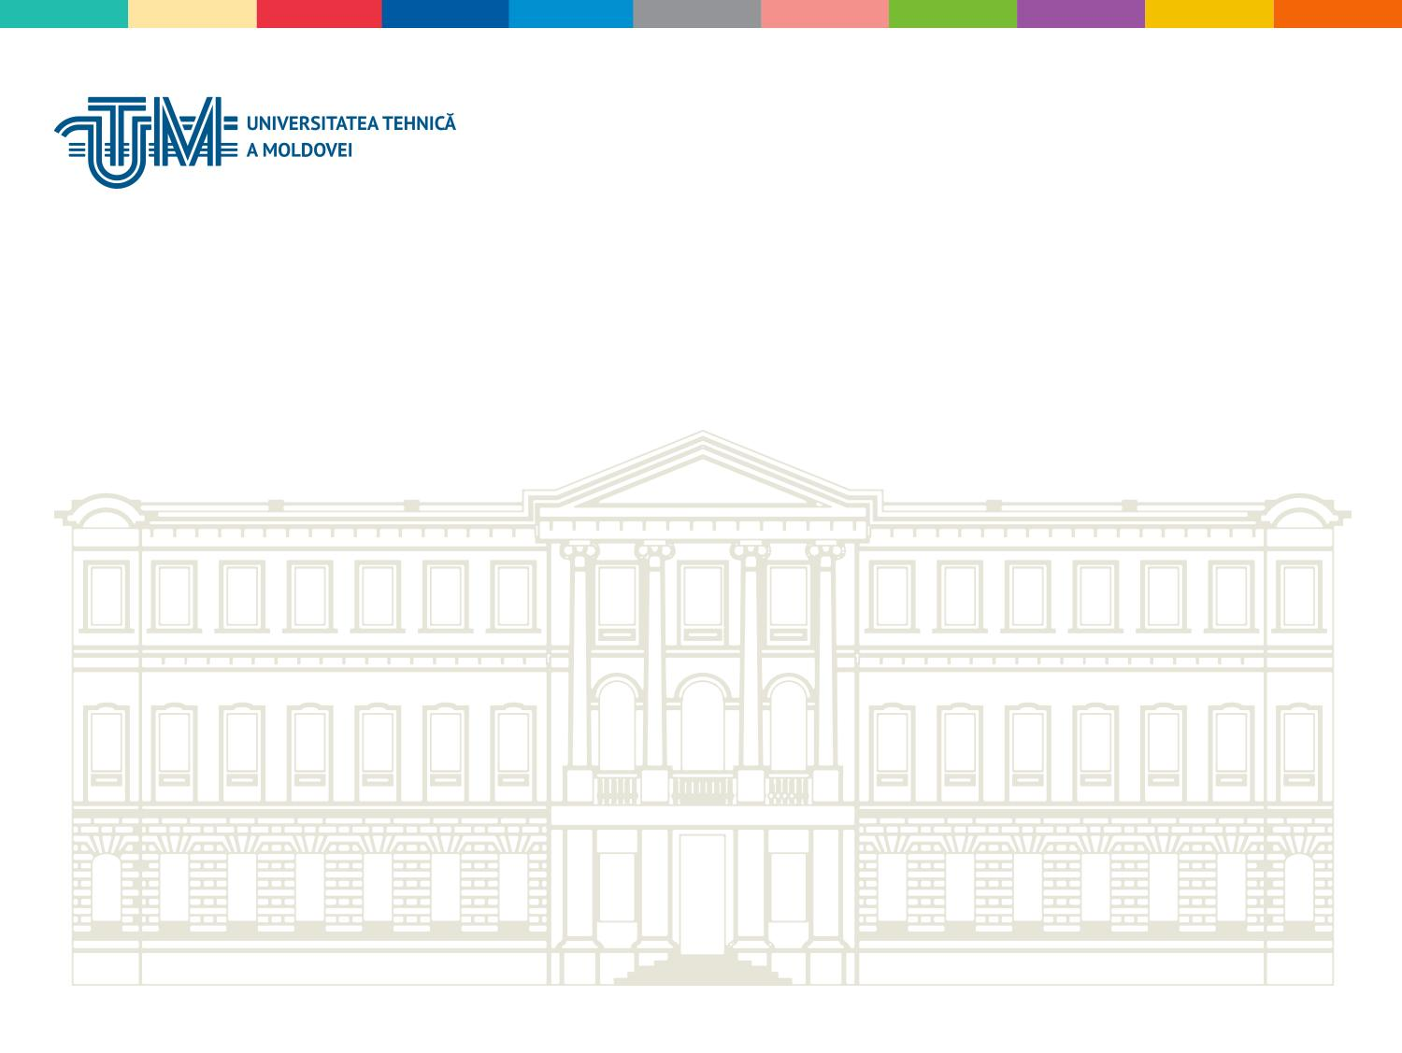
Computer Architecture
Fiștic Cristofor
Spring 2023

Slide 2
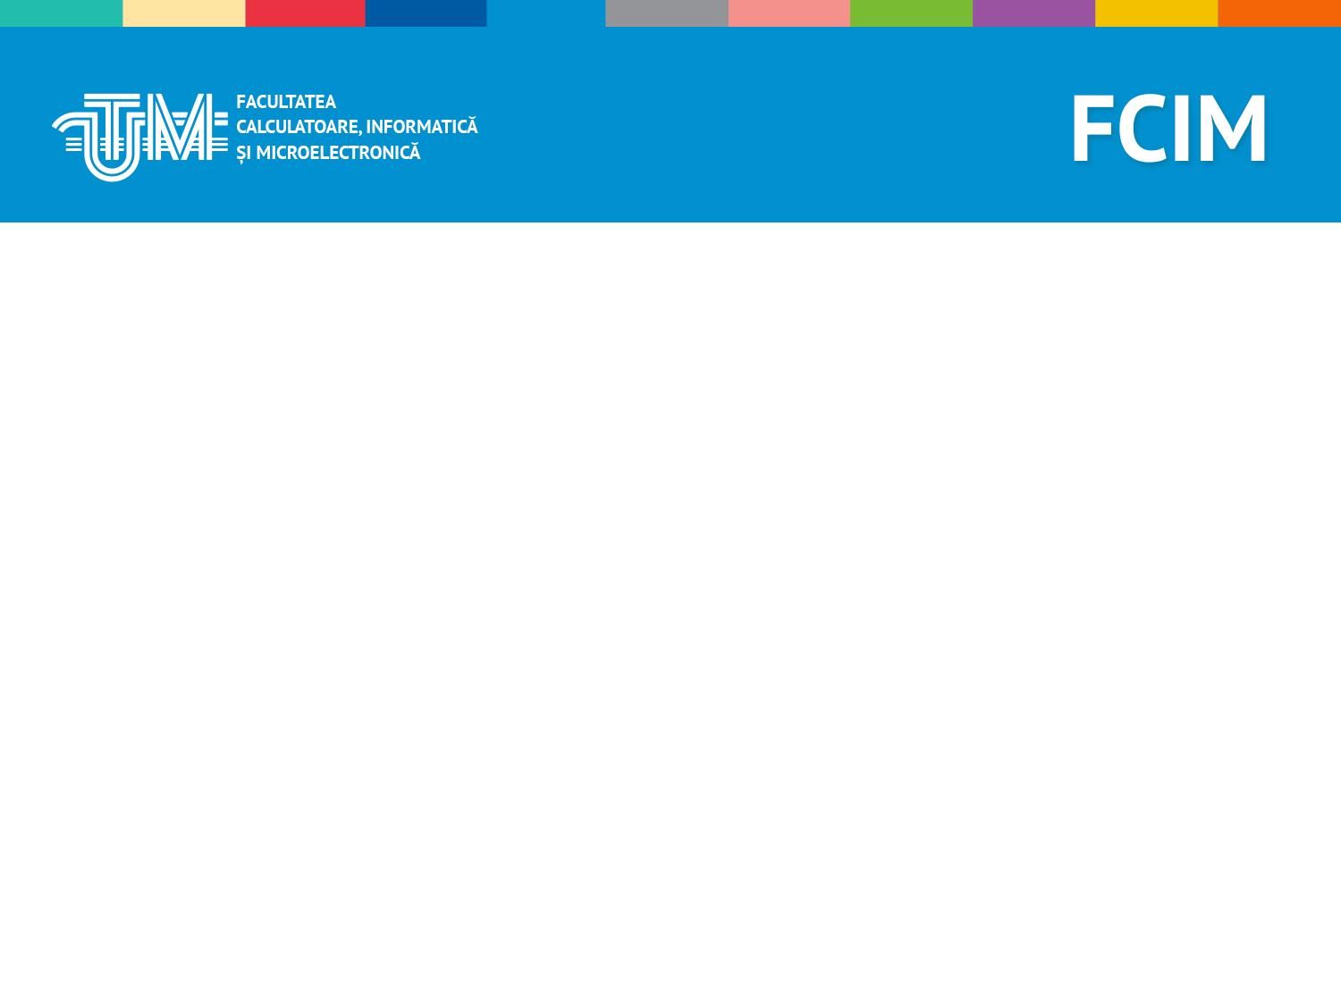
What is the computer architecture course about ?

Slide 3
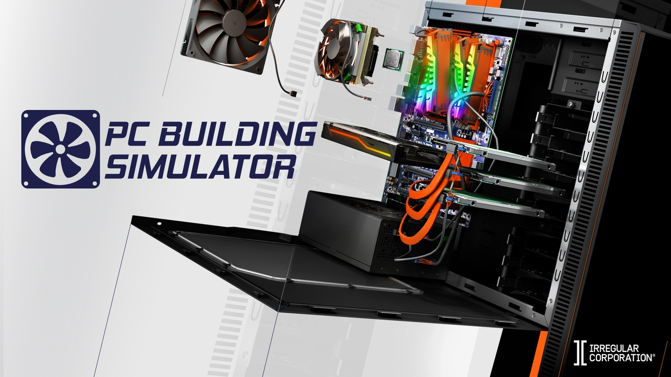

Slide 4
History of computers
1936 – Alan Turing had an idea for a universal machine, which he called the Turing machine, that could compute anything that could be computed

Slide 5
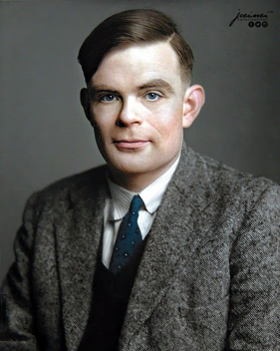
- Turing was highly influential in the development of theoretical computer science, providing a formalisation of the concepts of algorithm and computation with the Turing machine, which can be considered a model of a general-purpose computer.
- He is widely considered to be the father of theoretical computer science and artificial intelligence.

Slide 6
History of computers
John von Neumann is perhaps best known known for his work in the early development of computers. The concept of programming computers by storing data in memory and programs. This concept forms the basis of modern computers 1946.

Slide 7
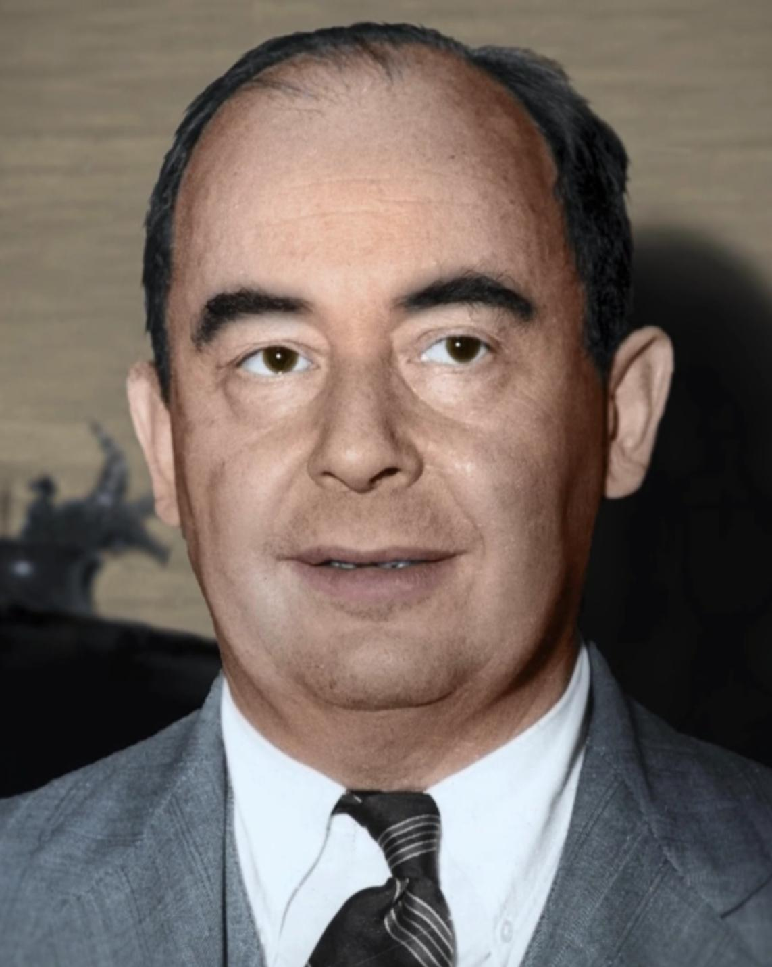
- The use of the binary system instead of the decimal system
- He developed MANIAC (mathematical analyzer, numerical integrator and computer), which was at the time the fastest computer of its kind.
- He was a pioneer of the application of operator theory to quantum mechanics in the development of functional analysis, and a key figure in the development of game theory and the concepts of cellular automata, the universal constructor and the digital computer.

Slide 8
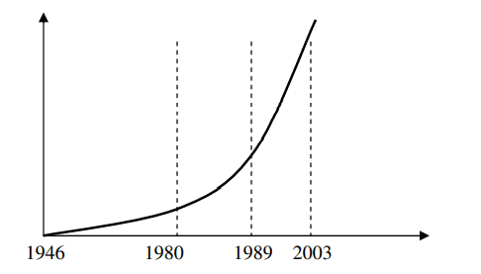
History of computers

Slide 9
History of computers
1st Generation: This was from the period of 1940 to 1955. This was when machine language was developed for the use of computers. They used vacuum tubes for the circuitry. For the purpose of memory, they used magnetic drums. These machines were complicated, large, and expensive. They were mostly reliant on batch operating systems and punch cards. As output and input devices, magnetic tape and paper tape were implemented. For example, ENIAC, UNIVAC-1, EDVAC, and so on.

Slide 10
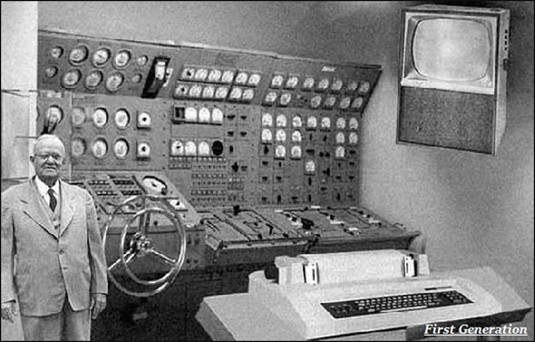
History of computers

Slide 11
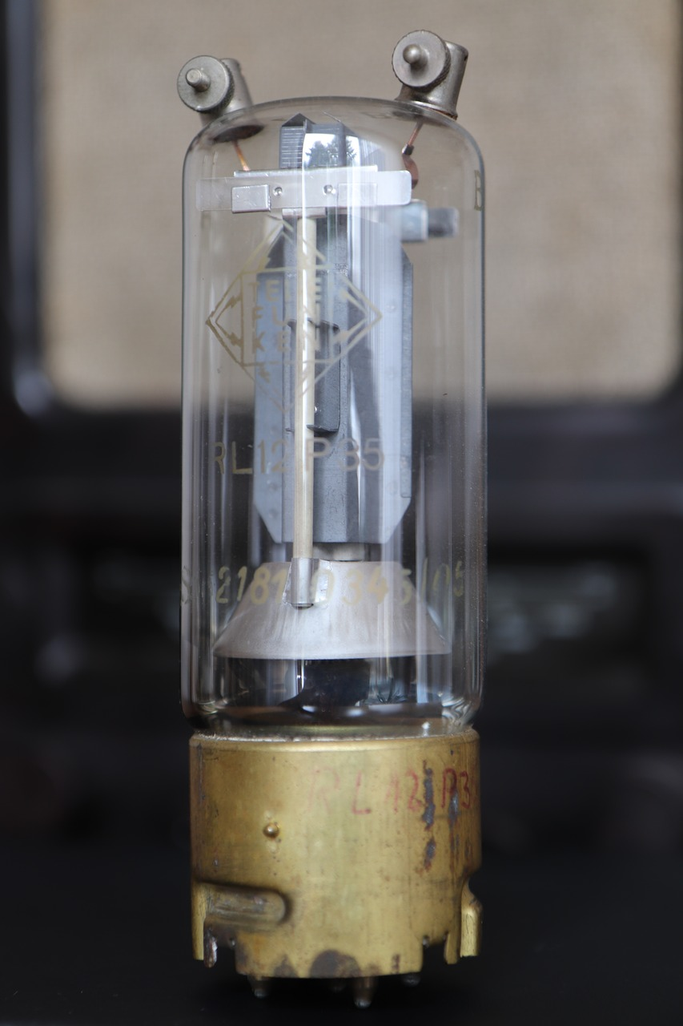
History of computers
Vacuum tube – an electronic device that controls the flow of electrons in a vacuum. It used as a switch, amplifier, or display screen in many older model radios, televisions, computers, etc.

Slide 12
History of computers
2nd Generation: The years 1957-1963 were referred to as the “second generation of computers” at the time. In second-generation computers, COBOL and FORTRAN are employed as assembly languages and programming languages. Here they advanced from vacuum tubes to transistors. This made the computers smaller, faster and more energy-efficient. And they advanced from binary to assembly languages. For instance, IBM 1620, IBM 7094, CDC 1604, CDC 3600, and so forth.

Slide 13
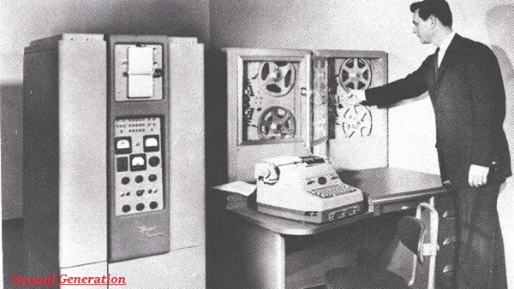
History of computers

Slide 14
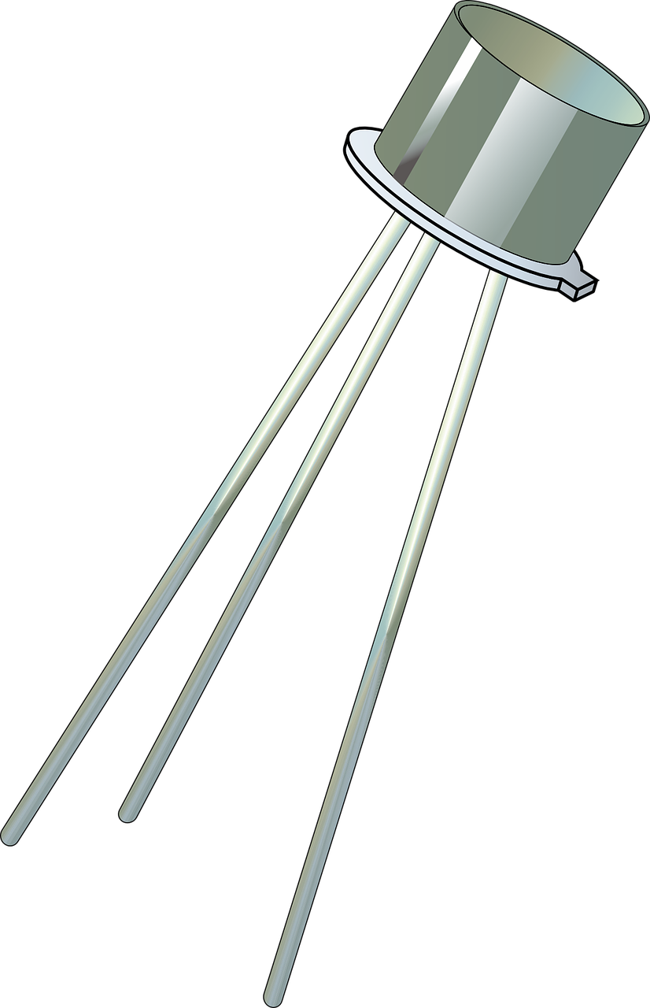
History of computers
Transistor – an electronic component that can be used as an amplifier or as a switch. It is used to control the flow of electricity in radios, televisions, computers, etc.

Slide 15
History of computers
3rd Generation: The hallmark of this period (1964-1971) was the development of the integrated circuit. A single integrated circuit (IC) is made up of many transistors, which increases the power of a computer while simultaneously lowering its cost. These computers were quicker, smaller, more reliable, and less expensive than their predecessors. High-level programming languages such as FORTRON-II to IV, COBOL, and PASCAL PL/1 were utilized. For example, the IBM-360 series, the Honeywell-6000 series, and the IBM-370/168.

Slide 16
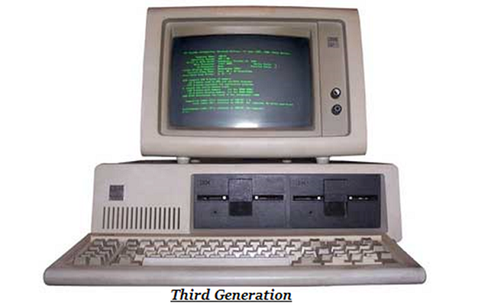
History of computers

Slide 17
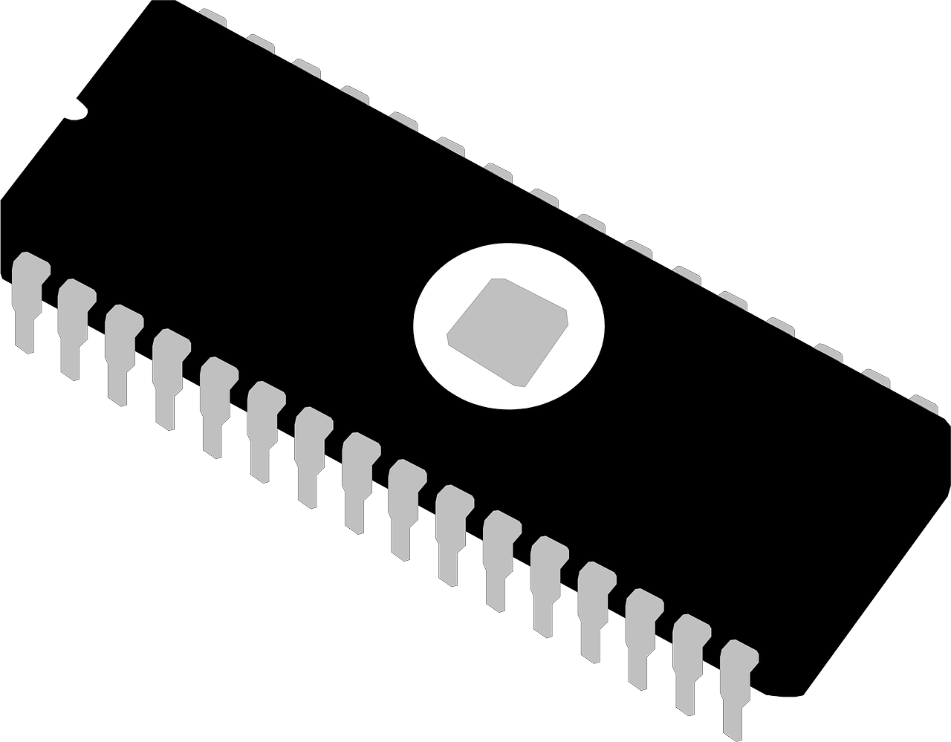
History of computers
Integrated circuit (IC) – a small electronic circuit printed on a chip (usually made of silicon) that contains many its own circuit elements (e.g. transistors, diodes, resistors, etc.).

Slide 18
History of computers
4th Generation: The invention of the microprocessors brought along the fourth generation of computers. The years 1971-1980 were dominated by fourth generation computers. C, C++ and Java were the programming languages utilized in this generation of computers. For instance, the STAR 1000, PDP 11, CRAY-1, CRAY-X-MP, and Apple II. This was when we started producing computers for home use.

Slide 19
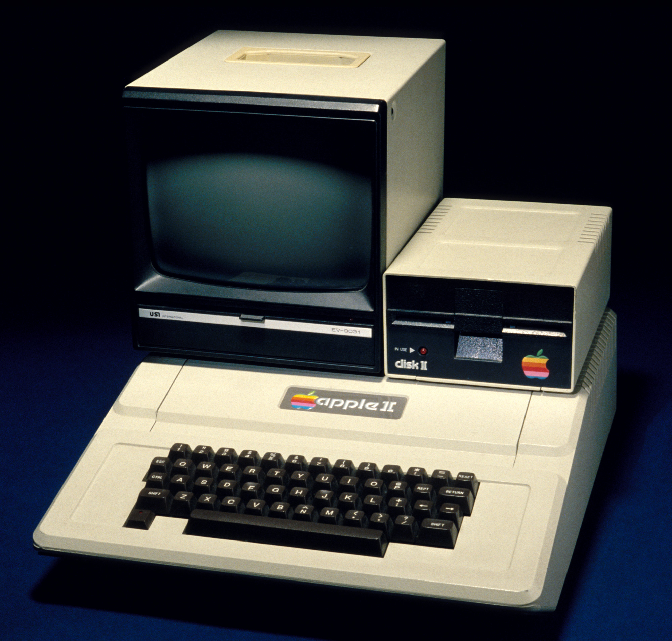
History of computers

Slide 20
History of computers
5th Generation: These computers have been utilized since 1980 and continue to be used now. This is the present and the future of the computer world. The defining aspect of this generation is artificial intelligence. The use of parallel processing and superconductors are making this a reality and provide a lot of scope for the future. Fifth-generation computers use ULSI (Ultra Large Scale Integration) technology. These are the most recent and sophisticated computers. C, C++, Java,.Net, and more programming languages are used. For instance, IBM, Pentium, Desktop, Laptop, Notebook, Ultrabook, and so on.

Slide 21
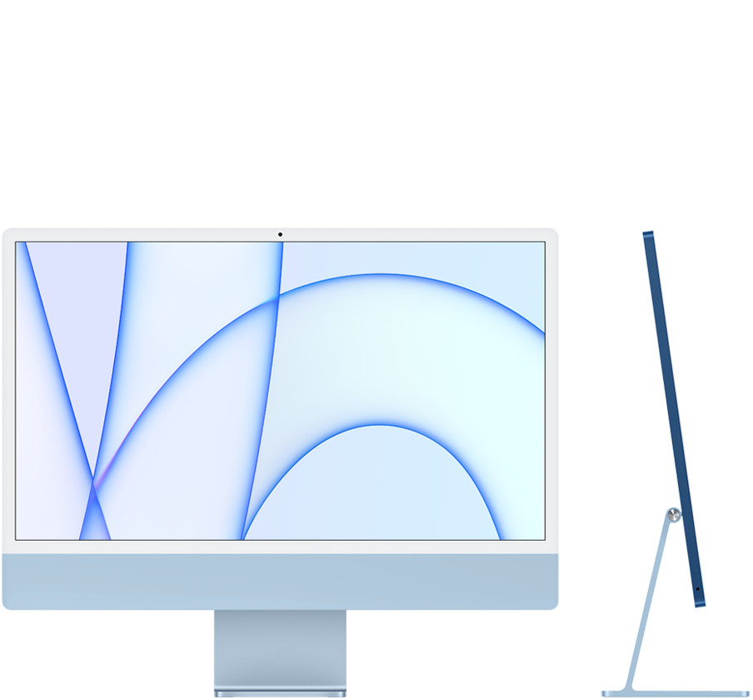
History of computers

Slide 22
History of computers
Future generations - As of 2023, most still consider us to be in the fifth generation as AI continues to develop. One possible contender for a future sixth generation is the quantum computer. However, until quantum computing becomes more developed and widely used, it is still only a promising idea. Some people also consider nanotechnology to be part of the sixth generation. Like quantum computing, nanotechnology is largely still in its infancy and requires more development before becoming widely used. With a new generation of computers it's also possible how we interact with a computer may also change. New ways of how we may interact with the next generation of computers include only using our voice, AR (augmented reality), VR (virtual reality), or MR (mixed reality).

Slide 23
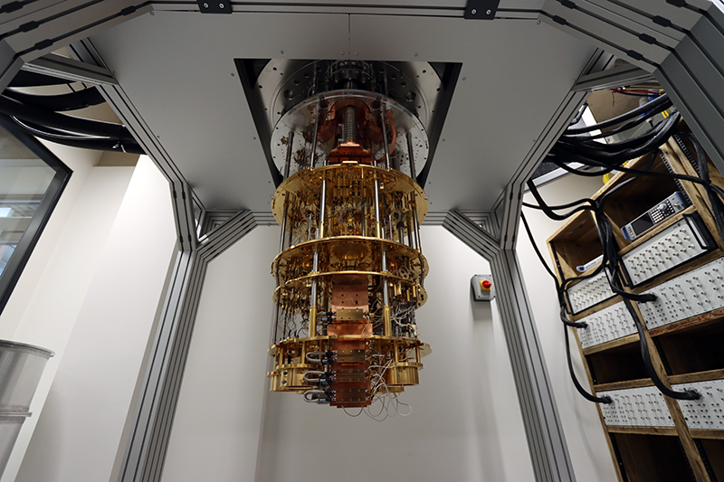
History of computers

Slide 24
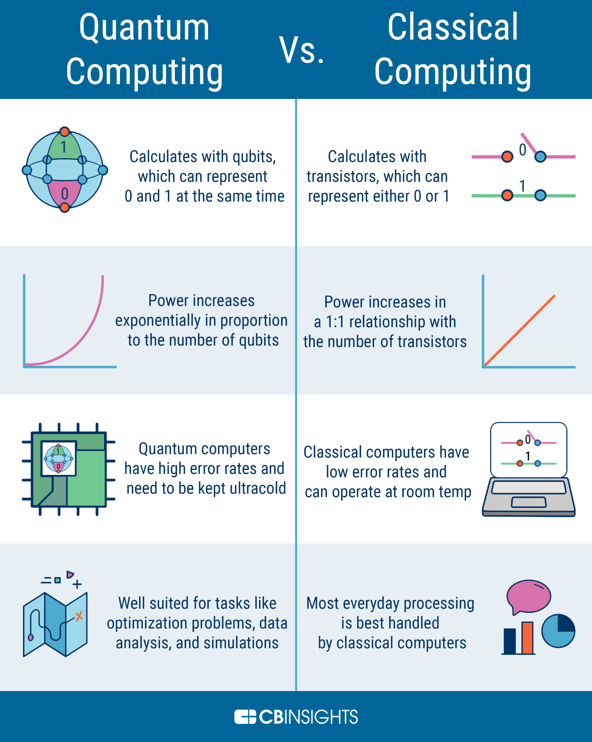
History of computers

Slide 25
General concepts

Slide 26
General concepts
The word System is derived from Greek word Systema, which means an organized relationship between any set of components to achieve some common cause or objective.
A system is “an orderly grouping of interdependent components linked together according to a plan to achieve a specific goal.”

Slide 27
General concepts
A system must have three basic constraints:
A system must have some structure and behavior which is designed to achieve a predefined objective.
Interconnectivity and interdependence must exist among the system components.
The objectives of the organization have a higher priority than the objectives of its subsystems

Slide 28
General concepts
A system must have three basic constraints:
A system must have some structure and behavior which is designed to achieve a predefined objective.
Interconnectivity and interdependence must exist among the system components.
The objectives of the organization have a higher priority than the objectives of its subsystems

Slide 29
Properties of a System
Organization - Organization implies structure and order. It is the arrangement of components that helps to achieve predetermined objectives.

Slide 30
Properties of a System
Interaction - It is defined by the manner in which the components operate with each other. For example, in an organization, purchasing department must interact with production department and payroll with personnel department

Slide 31
Properties of a System
Interdependence - Interdependence means how the components of a system depend on one another. For proper functioning, the components are coordinated and linked together according to a specified plan. The output of one subsystem is the required by other subsystem as input.

Slide 32
Properties of a System
Integration - Integration is concerned with how a system components are connected together. It means that the parts of the system work together within the system even if each part performs a unique function.

Slide 33
Properties of a System
Central Objective - The objective of system must be central. It may be real or stated. It is not uncommon for an organization to state an objective and operate to achieve another. The users must know the main objective of a computer application early in the analysis for a successful design and conversion.

Slide 34
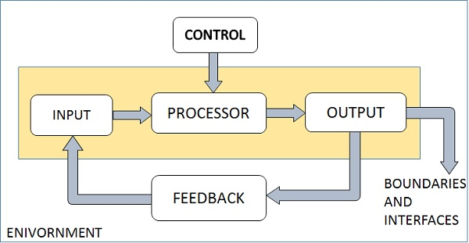
Properties of a System

Slide 35
Type of systems
Physical or Abstract Systems - Physical systems are tangible entities. We can touch and feel them. Physical System may be static or dynamic in nature. For example, desks and chairs are the physical parts of computer center which are static. A programmed computer is a dynamic system in which programs, data, and applications can change according to the user's needs. Abstract systems are non-physical entities or conceptual that may be formulas, representation or model of a real system

Slide 36
Type of systems
Open or Closed Systems - An open system must interact with its environment. It receives inputs from and delivers outputs to the outside of the system. For example, an information system which must adapt to the changing environmental conditions. A closed system does not interact with its environment. It is isolated from environmental influences. A completely closed system is rare in reality.

Slide 37
Type of systems
Adaptive and Non Adaptive System - Adaptive System responds to the change in the environment in a way to improve their performance and to survive. For example, human beings, animals. Non Adaptive System is the system which does not respond to the environment. For example, machines

Slide 38
General concepts
Program - an algorithmic solution to a problem written in a language, called a programming language.
An algorithm - sequential solution to a problem.
Machine language - is the language executed by the machine

Slide 39
General concepts
Black box - a black box is a system which can be viewed in terms of its inputs and outputs (or transfer characteristics), without any knowledge of its internal workings. Its implementation is "opaque" (black). The term can be used to refer to many inner workings, such as those of a transistor, an engine, an algorithm, the human brain, or an institution or government.

Slide 40

General concepts

Slide 41
General concepts
Computer architecture - is the theory behind construction of a computer. In the same way that an architect establishes the principles and the principles and objectives of building a project as the basis for construction plans, in the same way a computer architect establishes computer system architecture as the basis of design specifications. The primary objective in the architecture of a computer system is a relationship cost/performance ratio.

Slide 42
General concepts
System component = black box.
System architecture = the arrangement and interconnection of components to achieve
desired system functionality.

Slide 43
General concepts
System component = black box.
System architecture = the arrangement and interconnection of components to achieve
desired system functionality.

Slide 44
General concepts
General architectures:
Multilayer architecture - hierarchical levels. A lower level provides support to the for the execution of its functions
Functional decomposition - decomposition of components according to functions performed
Conceptual decomposition - decomposition of the system by entities entities identified (encompassing all the functionality of the object).

Slide 45
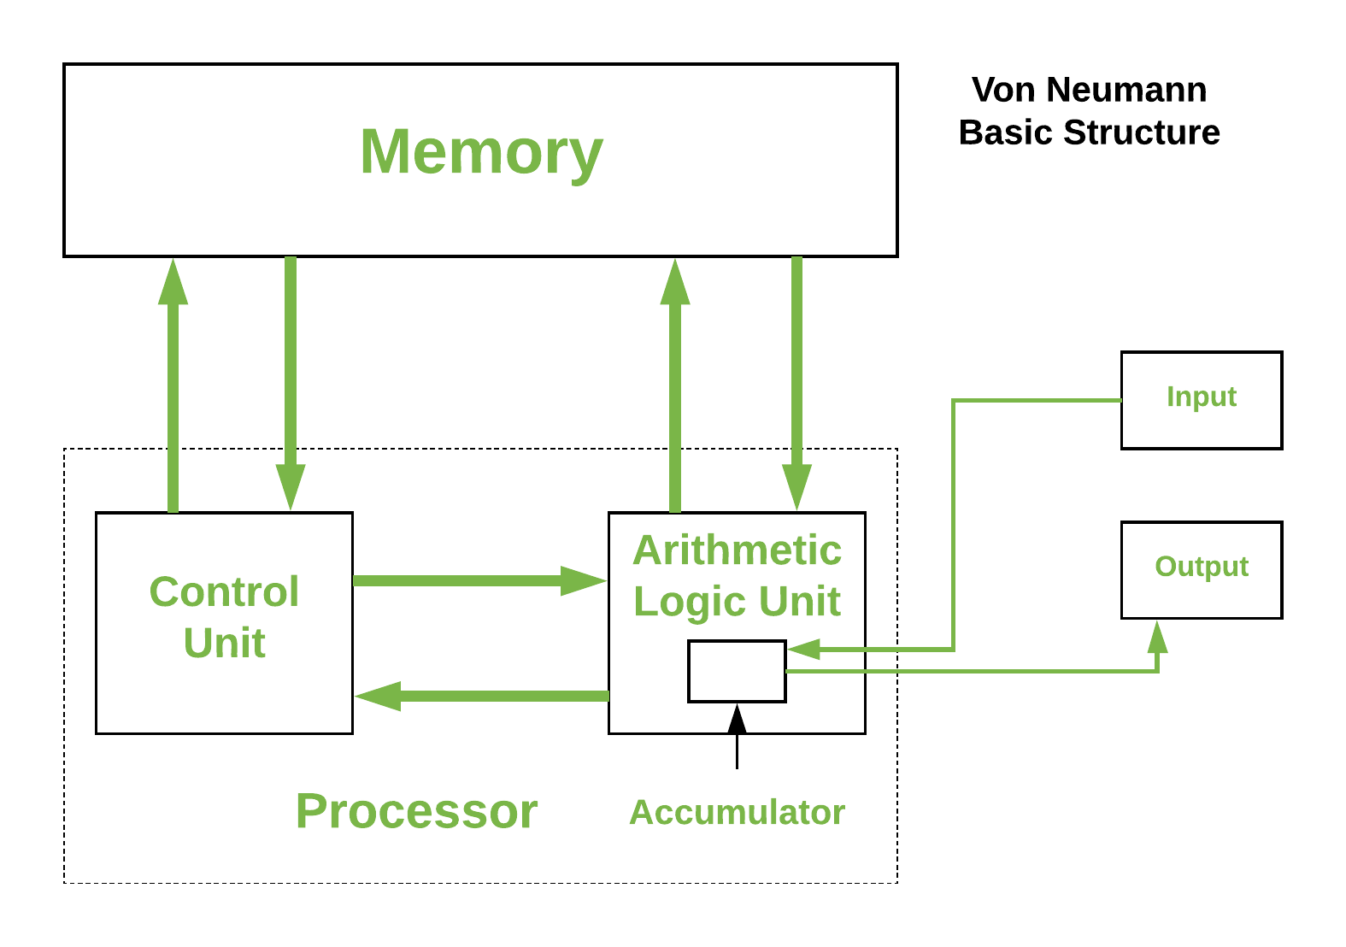
General concepts

Slide 46
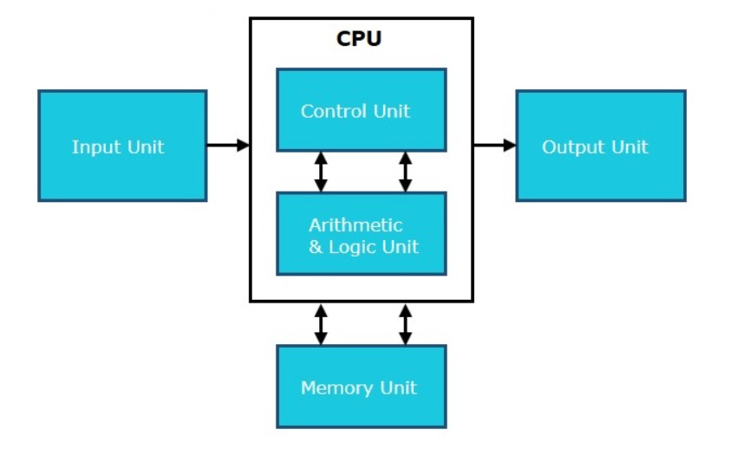
General concepts

Slide 47
General concepts
Moore's law is the observation that the number of transistors in a dense integrated circuit (IC) doubles about every two years. Moore's law is an observation and projection of a historical trend. Rather than a law of physics, it is an empirical relationship linked to gains from experience in production.

Slide 48
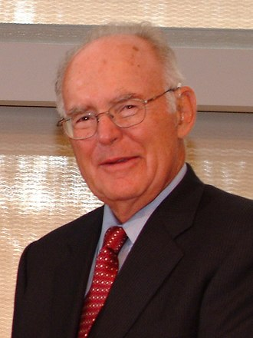
General concepts
The observation is named after Gordon Moore, the co-founder of Fairchild Semiconductor and Intel (and former CEO of the latter), who in 1965 posited a doubling every year in the number of components per integrated circuit, and projected this rate of growth would continue for at least another decade.

Slide 49
General concepts
Industry experts have not reached a consensus on exactly when Moore's law will cease to apply. Microprocessor architects report that semiconductor advancement has slowed industry-wide since around 2010, slightly below the pace predicted by Moore's law. In September 2022 Nvidia CEO Jensen Huang claimed that Moore's law is dead; meanwhile, Intel CEO Pat Gelsinger claimed the opposite.

Slide 50
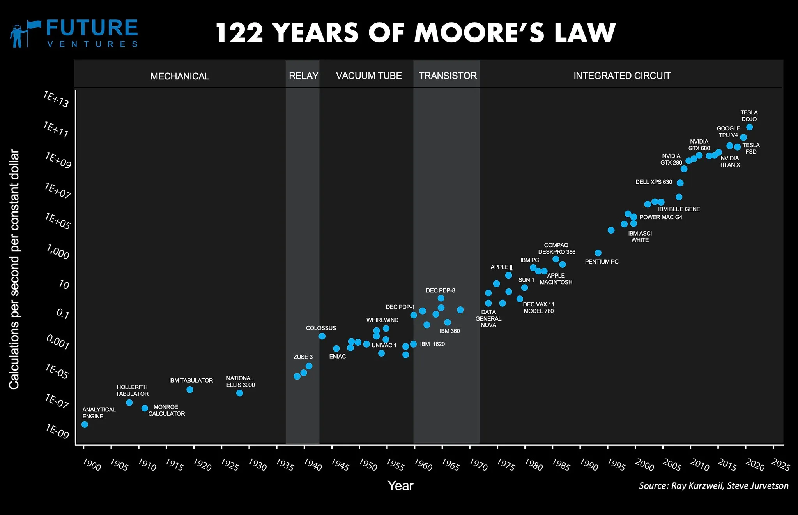
General concepts

Slide 51
General concepts
Nathan’s laws of software -
Software is a gas - it expands to fit the container it is in
Software grows until it becomes limited by Moore’s Law
Software growth makes Moore’s Law possible
Software is only limited by human ambition and expectation

Slide 52
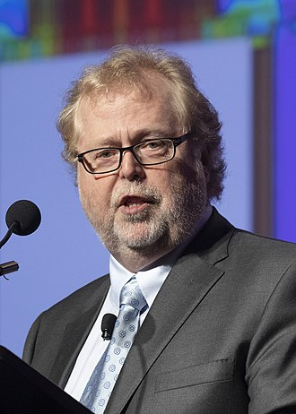
General concepts
Way back in 1997, Nathan Myhrvold wrote a paper entitled “The Next Fifty Years of Software” (Subtitled “Software: The Crisis Continues!”) which was presented at the ACM97 conference (focused on the next 50 years of computing).

Slide 53
General concepts
There is a problem with modern computing called 'software bloat', which essentially means that software keeps getting larger as computer performance requirements increase. In the past, software was meticulously designed to make the most of what was available.
As time went on, computers became exponentially faster, able to hold vastly more information while reducing overall costs. This development has led to an impasse where, essentially, software is incapable of keeping up with hardware. As software becomes more complex, it is harder to manage and to find its bugs.

Slide 54
General concepts
Donald Knuth, author of The Art of Computer Programming said:
“People who are more than casually interested in computers should have at least some idea of what the underlying hardware is like. Otherwise the programs they write will be pretty weird.”

Slide 55
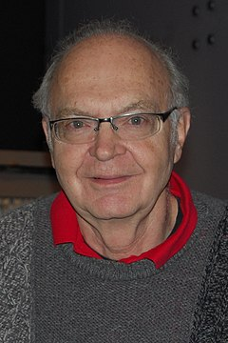
General concepts
Knuth has been called the "father of the analysis of algorithms".He is the author of the multi-volume work The Art of Computer Programming and contributed to the development of the rigorous analysis of the computational complexity of algorithms and systematized formal mathematical techniques for it. In the process, he also popularized the asymptotic notation. In addition to fundamental contributions in several branches of theoretical computer science.

Slide 56
Types of computers

Slide 57
-PC -Workstation -Minicomputer -Mainframe -Supercomputer

Slide 58
Computer components

Slide 60
Input Unit This unit contains devices with the help of which we enter data into the computer. This unit creates a link between the user and the computer. The input devices translate the information into a form understandable by the computer.
Output Unit
The output unit consists of devices with the help of which we get the information from the computer. This unit is a link between the computer and the users. Output devices translate the computer's output into a form understandable by the users.

Slide 61
CPU (Central Processing Unit) CPU is considered as the brain of the computer. CPU performs all types of data processing operations. It stores data, intermediate results, and instructions (program). It controls the operation of all parts of the computer. CPU itself has the following three components − -ALU (Arithmetic Logic Unit) -Memory Unit -Control Unit

Slide 62
Central Processing Unit (CPU)
Central Processing Unit (CPU) consists of the following features
-CPU is considered as the brain of the computer.
-CPU performs all types of data processing operations.
-It stores data, intermediate results, and instructions (program).
-It controls the operation of all parts of the computer.

Slide 63
Control Unit
This unit controls the operations of all parts of the computer but does not carry out any actual data processing operations.
Functions of this unit are:
-It is responsible for controlling the transfer of data and instructions among other units of a computer.
-It manages and coordinates all the units of the computer.
-It obtains the instructions from the memory, interprets them, and directs the operation of the computer.
-It communicates with Input/Output devices for transfer of data or results from storage.
-It does not process or store data.

Slide 64
Control Unit
This unit controls the operations of all parts of the computer but does not carry out any actual data processing operations.
Functions of this unit are:
-It is responsible for controlling the transfer of data and instructions among other units of a computer.
-It manages and coordinates all the units of the computer.
-It obtains the instructions from the memory, interprets them, and directs the operation of the computer.
-It communicates with Input/Output devices for transfer of data or results from storage.
-It does not process or store data.

Slide 65
ALU(Arithmetic Logic Unit)
This unit consists of two subsections namely,
-Arithmetic Section
-Logic Section

Slide 66
ALU(Arithmetic Logic Unit)
Arithmetic Section
Function of arithmetic section is to perform arithmetic operations like addition, subtraction, multiplication, and division. All complex operations are done by making repetitive use of the above operations

Slide 67
ALU(Arithmetic Logic Unit)
Logic Section
Function of logic section is to perform logic operations such as comparing, selecting, matching, and merging of data.

Slide 68
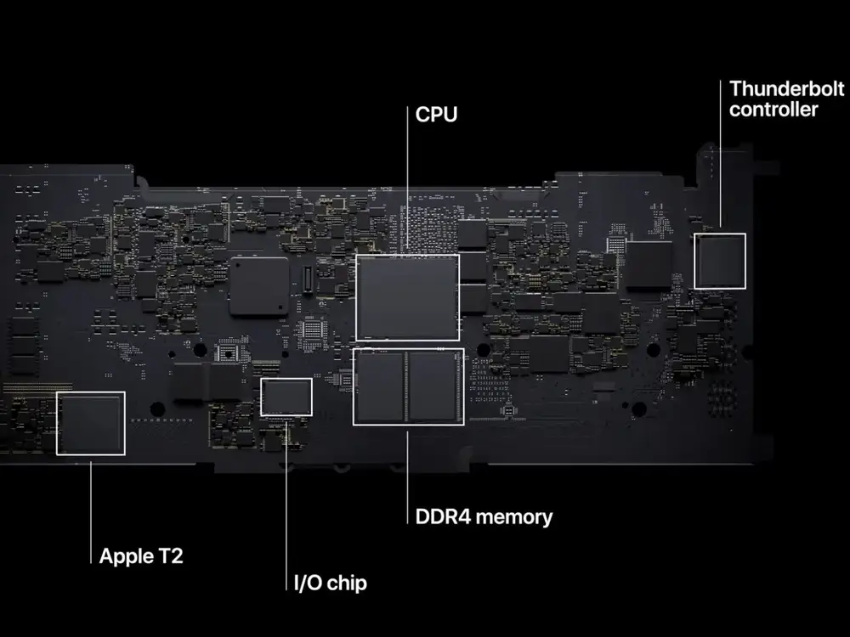

Slide 69
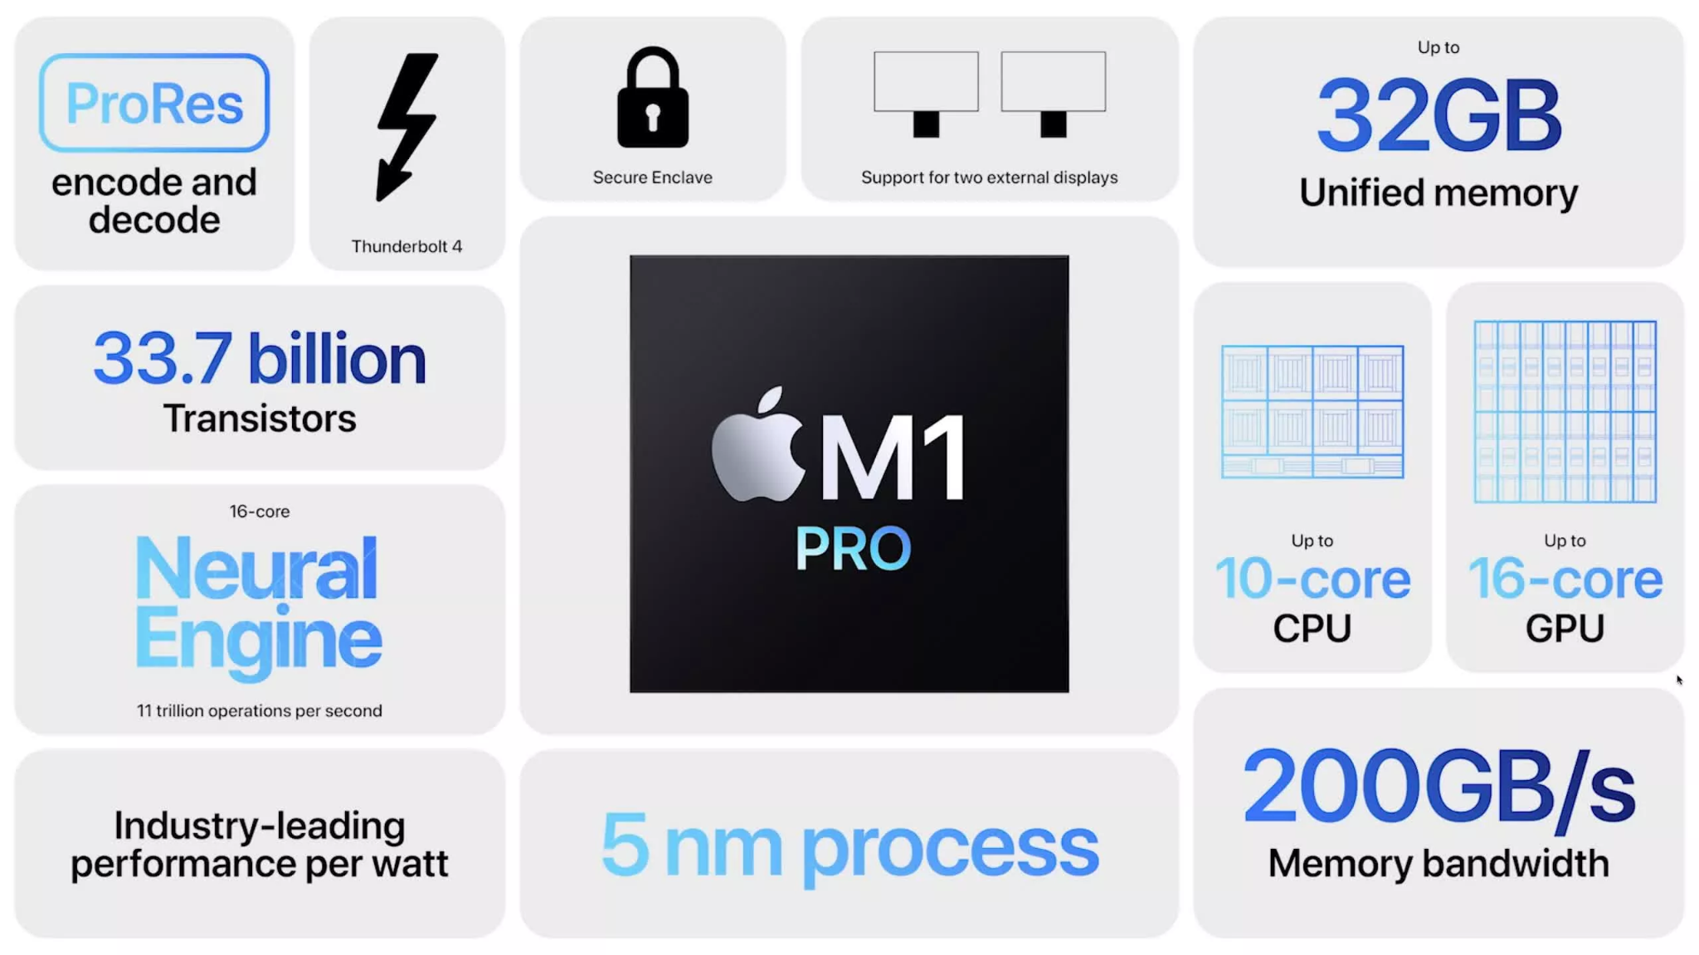

Slide 70
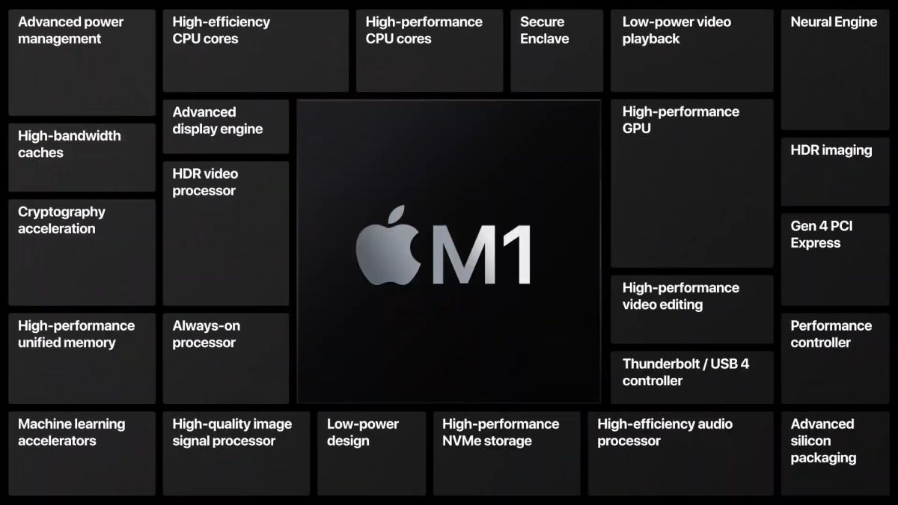

Slide 71
Computer components

Slide 72
Central processing unit (CPU)
The CPU controls the computer processes and communicates with the other components of a personal computer. A computer's CPU may be one of the most complicated parts of the computer because of its intricacies

Slide 73
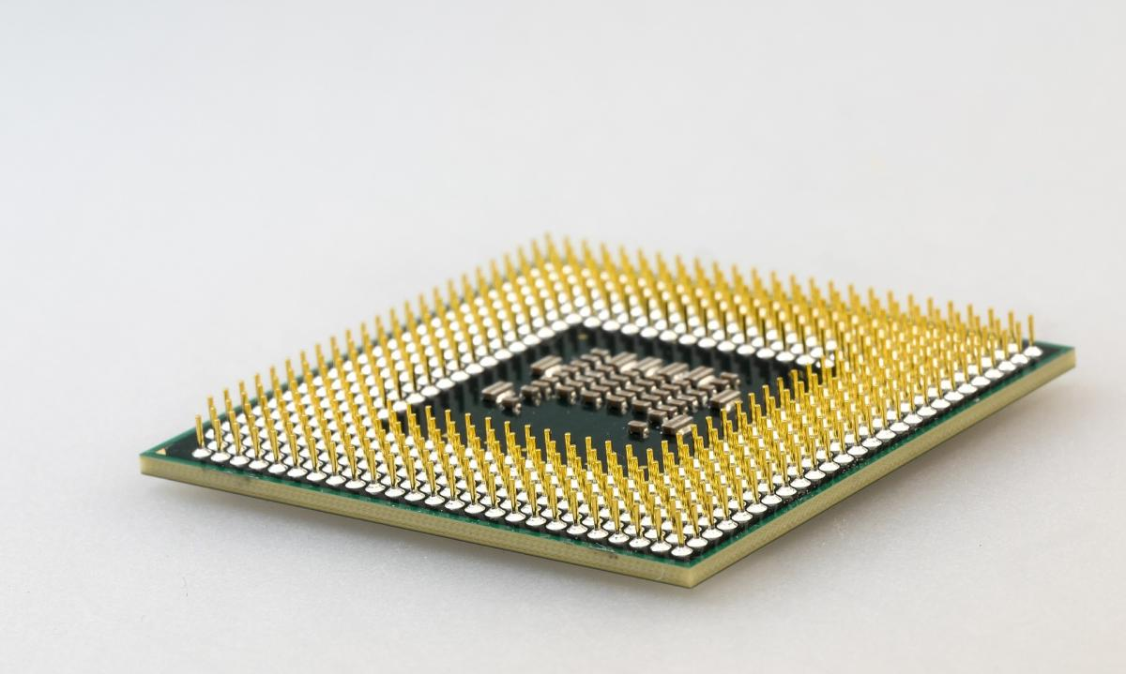

Slide 74
Motherboard
The motherboard provides the structure for all other components and connects them, while also providing a way to distribute power, deliver information and connect to devices such as a printer or mouse. It controls how data transfers and what type of monitor or screen device to use, for example. It houses the CPU, memory and secondary storage devices such as hard drives.

Slide 75
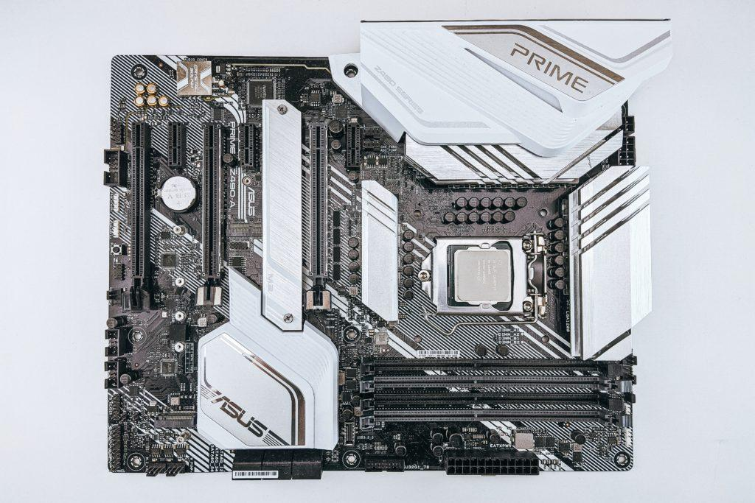

Slide 76
Random Access Memory (RAM)
RAM is where data lives temporarily while it's being actively used by programs, such as when a user launches a computer application. A technician may know how to identify the type of RAM in a computer, how to replace it if it's defective and how to diagnose problems with copying data from one location in memory to another.

Slide 77
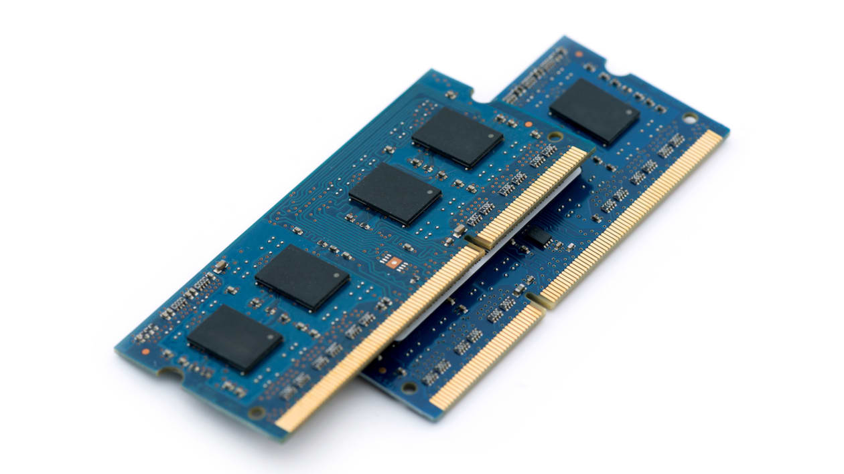

Slide 78
Power supply
A power supply provides electricity to all components of a computer system. Typically, it's a power cord connected from the back of a PC tower into an electricity socket.

Slide 79
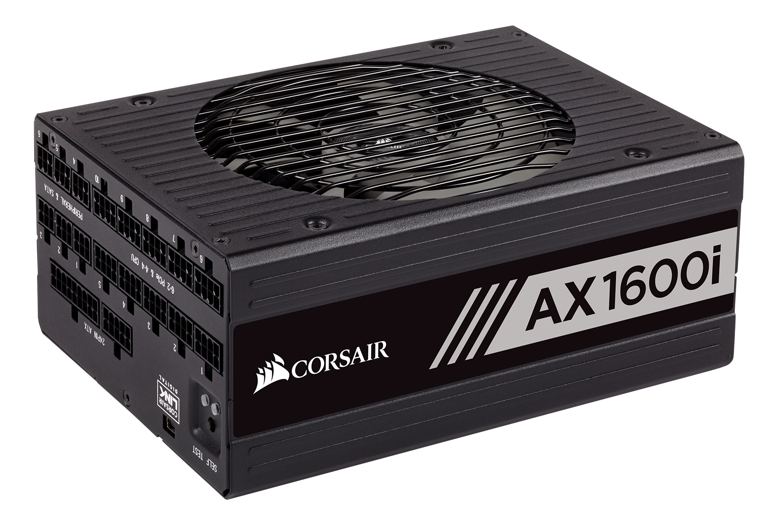

Slide 80
Cooling fan
Cooling fans are a computer's system to decrease overheating. Many computers have more than one cooling fan to help users who run their computer heavily, such as video streaming or gaming.

Slide 81
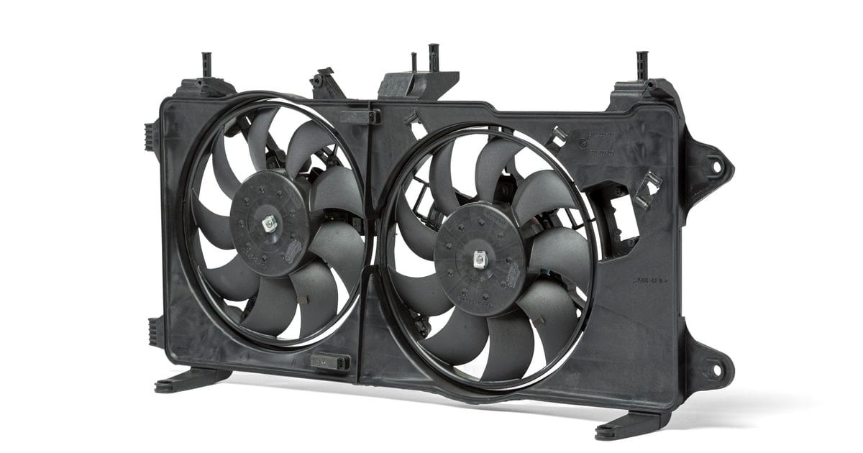

Slide 82
Graphical Processing Unit (GPU)
When handling graphical operations and advanced imagery, the graphical processing unit (GPU) is the computer hardware responsible for it. A GPU is required for your computer to read and reproduce graphical representations and effects, which are almost present in every form of media today.
However, the finest GPUs are primarily used for video gaming, capable of handling immense 3D-graphics loads to maintain smooth frame rates and lag-free experiences.
When gaming, the CPU and GPU work in tandem. The GPU manages the heavy lifting in terms of the on-screen graphics and fidelity, while the CPU runs the programming that works behind the scenes, such as data and in-game statistics.
A broken-down GPU can lead to many problems, including the feared black screen of death.. The current crisis of GPU chips shortages causes another headache, making losing your GPU a nightmare

Slide 83
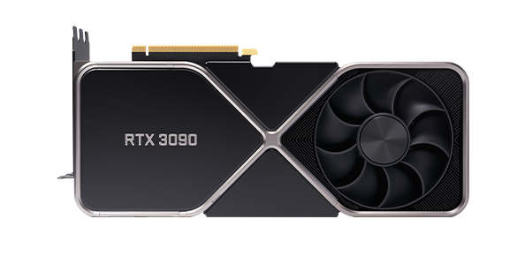

Slide 84
Hard drive
Hard drives are data storage devices used to store files, programs or other information on a computer system. They use magnetically coated discs called hard disks that store digital representations of information.

Slide 85
Storage device
A storage device provides the memory for installing programs and saving files. Unlike RAM, a storage device’s content is secured in non-volatile memory, meaning that data is saved permanently inside its memory bank, preserving them even after you turn off the PC (unless manually deleted or uninstalled).
PCs use 2 common types of internal storage devices: hard disk drives (HDDs) and solid-state drives (SDDs). HDDs are the cheaper option but suffer from slower transfer speeds, while SDDs are their superior counterparts but are more expensive. These devices are attached to your computer using dedicated SATA cables, replaced by SAS cables for big servers and workstations.
Other secondary storage devices exist, such as USB flash drives and portable HDDs. However, these peripherals are not installed inside computers. Instead, they are connected to the PC via alternative channels like USB ports or external disk drives, depending on the specs.
Even though storage devices do not impact your computer’s boot-up process, start-up programs like Google Chrome or Microsoft Word are loaded directly from your HDD or SDD. So a damaged storage device can interrupt the whole process, potentially corrupting your files. If so, you will need to replace your hard drive immediately, sometimes requiring a complete system reformat or Windows reinstall, which is a hassle.

Slide 86
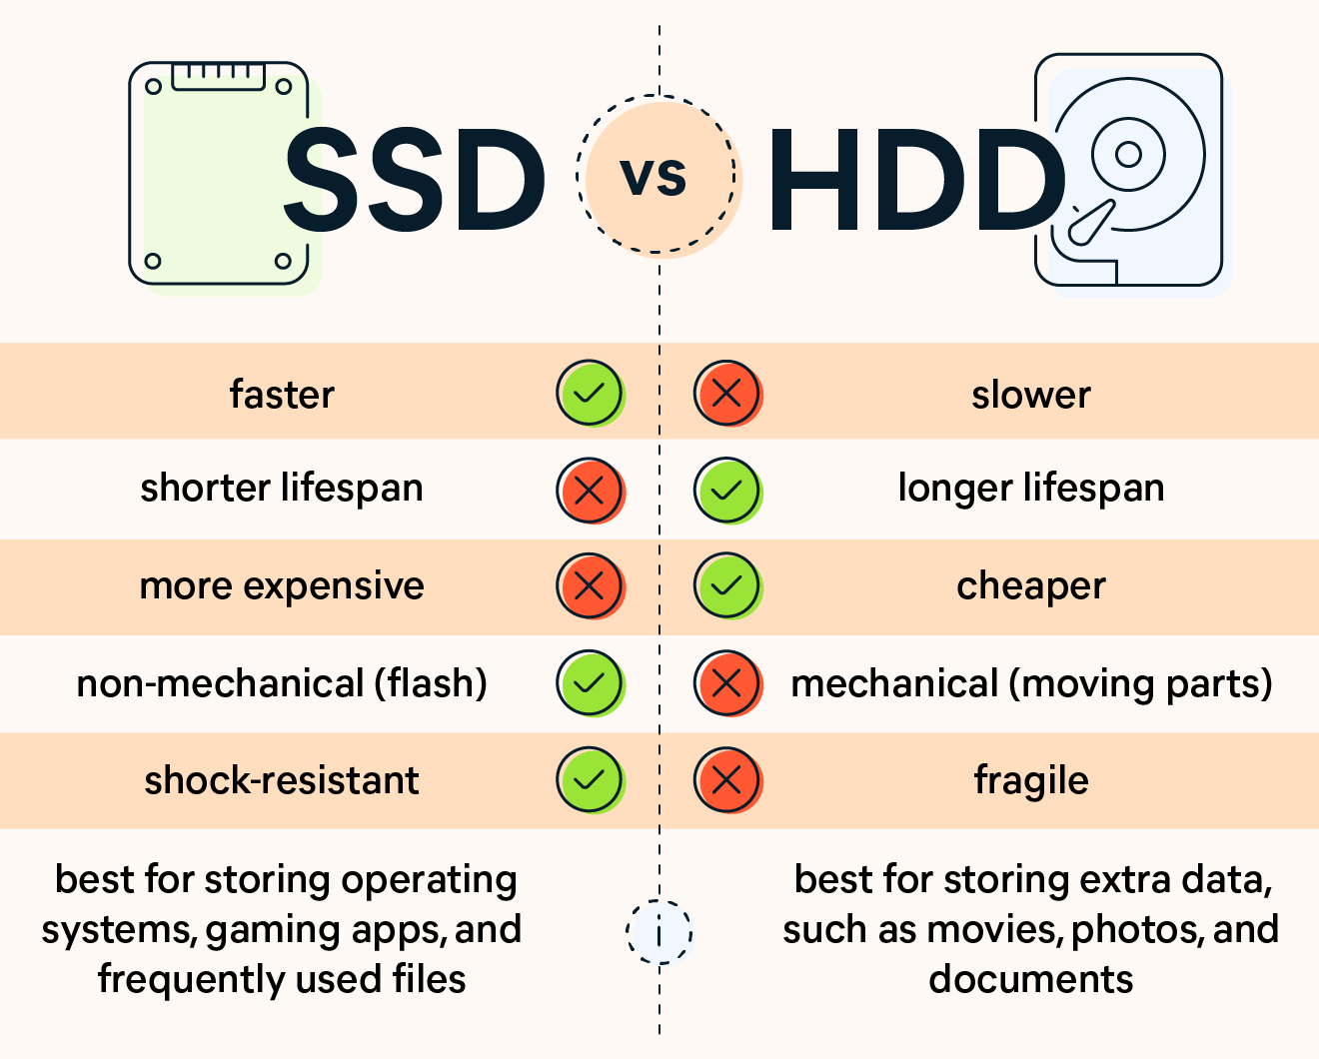

Slide 87
